Slide 1
Part Select Chat Agent
{
< by Collins Munene Kariuki >
}
...

Slide 2
Backend Setup Goals
The backend setup for the Instalily case study involved creating a robust server that can handle user queries about fridge & dishwasher parts.
<Set up a Node.js backend using Express and integrate it with the pre-existing frontend>
Goals:
{Scalability}: Design the backend to handle the increasing number of queries with the growing product catalog.
{Efficient}: Optimize the backend for quick responses to user queries.
{Reliable}: Build a reliable backend that provides accurate information based on the data available.
}
..
Notes:
"To begin, let's take a high-level look at the backend setup process for the Instalily case study. Our primary goal was to create a robust server capable of handling user queries related to refrigerator and dishwasher parts. The setup involved using Node.js with Express, integrating it with our frontend, and ensuring the system could process various user queries efficiently.”
The backend setup had several critical goals. First, we needed to ensure scalability, so the system could handle an increasing number of queries as our product catalog grows. We also focused on efficiency, optimizing the backend for quick responses to user queries. Finally, reliability was essential to provide accurate information based on the data available.

Slide 3
Backend Setup Overview
Brief outline:
Choosing the technology stack (Node.js with Express).
Setting up the backend (installing required dependencies like Axios).
Implementing backend functionality (defined endpoints to handle user queries)
Web scraping for data (using Cheerio and Axios).
Integrating scraped data (load scraped data in the backend).
Deploying the solution (deploying backend and frontend as a Chrome extension using the Side Panel API).
}
..
Notes:
Here is an outline of the steps we followed in setting up the backend:
Choosing the Technology Stack: We selected Node.js with Express for our backend. This choice was based on the asynchronous nature of Node.js and the strong community support for Express.
Setting Up the Backend: We initialized a new Node.js project, installed the necessary dependencies, created the server, and addressed potential port conflicts.
Implementing Backend Functionality: We defined endpoints to handle user queries and integrated the backend with our frontend by modifying the api.js file.
Web Scraping for Data: To make the backend scalable, we used Cheerio and Axios to scrape data from the PartSelect website. This data was stored in a JSON file for efficient querying.
Integrating Scraped Data: We loaded the scraped data into the backend and used it to respond accurately to various user queries.
Deploying the Solution: Finally, we detailed the steps for deploying the backend and frontend as a Chrome extension using the Side Panel API."

Slide 4
Choosing the Technology Stack
Choosing Node.js:
Asynchronous nature: Node.js is lightweight, efficient, and can handle multiple simultaneous requests, essential for a chat application.
Popularity & community support.
JavaScript everywhere: Allows us to use JS on both the client and server sides.
Express has a powerful routing mechanism that allows for the definition of route handlers for different HTTP methods and URL paths.
Axios provides a simple and concise API for making HTTP requests.
CORS helps in securing your application by allowing controlled access to resources located outside of a given domain.
}
..
Notes:
In this initial step, the focus was on selecting the most suitable technology stack for the backend. Choosing the right stack is crucial as it impacts the performance, scalability, and maintainability of the application.
"We chose Node.js for the backend for several reasons…”
"Express is a minimal and flexible Node.js web application framework that provides a robust set of features for web and mobile applications. It was chosen for several reasons…”
"Axios is a promise-based HTTP client for the browser and Node.js. It was chosen for several reasons…”
"Cors is a node.js package for providing a Connect/Express middleware that can be used to enable CORS (Cross-Origin Resource Sharing) with various options. It was chosen for…”
By choosing Node.js, Express, Axios, and CORS, we have a solid technology stack that supports our goals of scalability, extensibility, efficiency, and reliability. These technologies provide the necessary tools and frameworks to build a robust backend that can handle multiple user queries effectively.

Slide 5
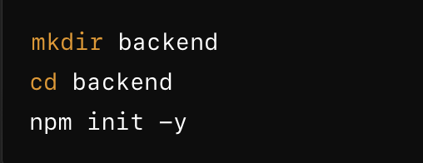


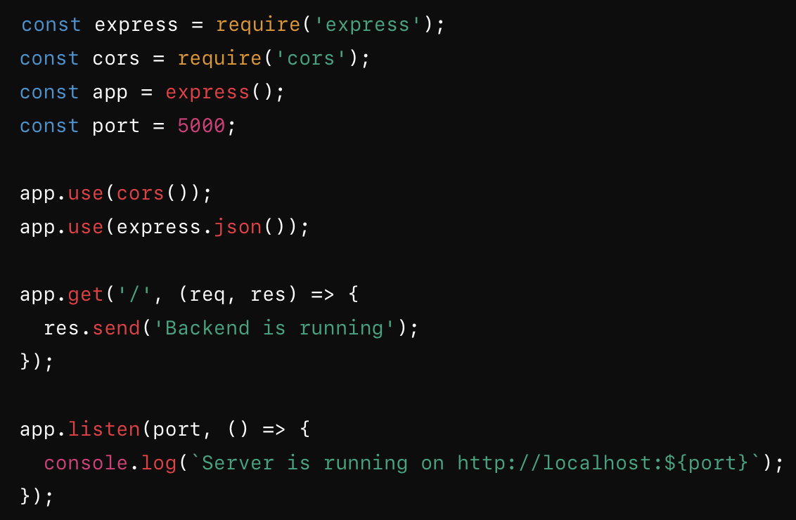
Setting up the Backend
2. Install the necessary packages
4. Starting the backend server.
1. Initializes a new Node.js project with default settings, creating a `package.json` file.
}
..
3. Create the server.
Notes:
In this step, we focus on setting up the backend. This involves initializing a new Node.js project, installing the required dependencies, creating the server, and starting it. Let's go through each of these sub-steps in detail.
We begin by creating a new directory for the backend and navigating into it. Then, we initialize a new Node.js project using npm init -y. This command generates a package.json file with default settings, which is essential for managing the project's dependencies and scripts.
Next, we install the necessary packages for our project. We need Express for building the server (A web application framework for Node.js.), Axios for making HTTP requests, and Cors for enabling Cross-Origin Resource Sharing.
Now, we create the server by setting up an Express application. We define the port number and configure middleware for CORS and JSON parsing. We also add a basic route to ensure the server is running.
Finally, we start the server using the node command. This will run the server.js file, and we should see a message indicating that the server is running.
By following these steps, we have successfully set up the backend for our project. We now have a running Express server that will serve as the foundation for our backend functionality.

Slide 6
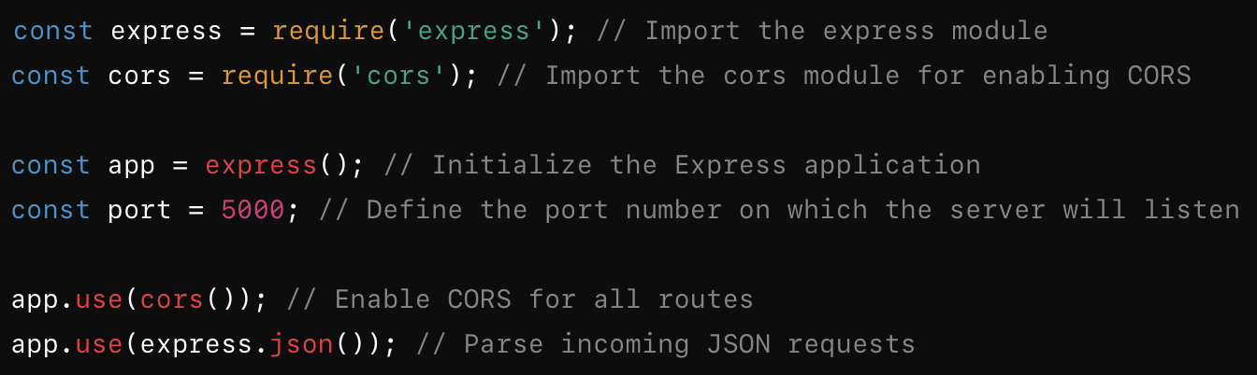
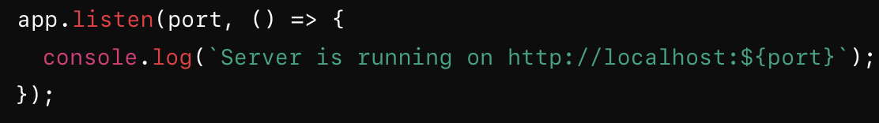
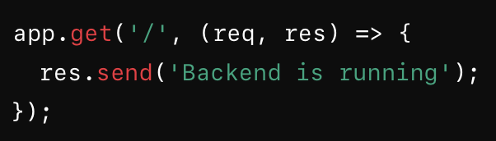
Creating the Server
3. We start the server using the listen method which will make the server start listening for incoming requests.
1. Create a file named server.js, which will contain all the code necessary to set up and run our server, in our backend directory
Challenge faced: I encountered an "Address already in use" error, indicating that the port was occupied by another process. Initially, I tried to resolve this by identifying and stopping the process using the port, but there were too many processes to terminate. Therefore, I opted to change the port number instead.
2. We add a basic route to ensure our server is running correctly.
}
..
Notes:
In this step, we'll create the server using Express. This involves setting up the basic structure of our server, configuring middleware, and adding routes to handle requests. Let's dive into the details.
We start by creating a file named server.js in our backend directory. This file will contain all the code necessary to set up and run our server.
Next, we add a basic route to ensure that our server is running correctly. This route will respond with a simple message when accessed.
Finally, we start the server using the listen method. This will make the server start listening for incoming requests on the specified port.
By following these steps, we have successfully set up the server for our project. We now have a running Express server that will serve as the foundation for our backend functionality. This server is configured to handle requests, parse JSON data, and support cross-origin requests, making it ready for further development.
In summary, creating the server involved importing necessary modules, setting up an Express application, configuring middleware, adding basic routes, and handling potential port conflicts. This foundational setup ensures that our backend is ready to handle incoming requests and process data efficiently.

Slide 7
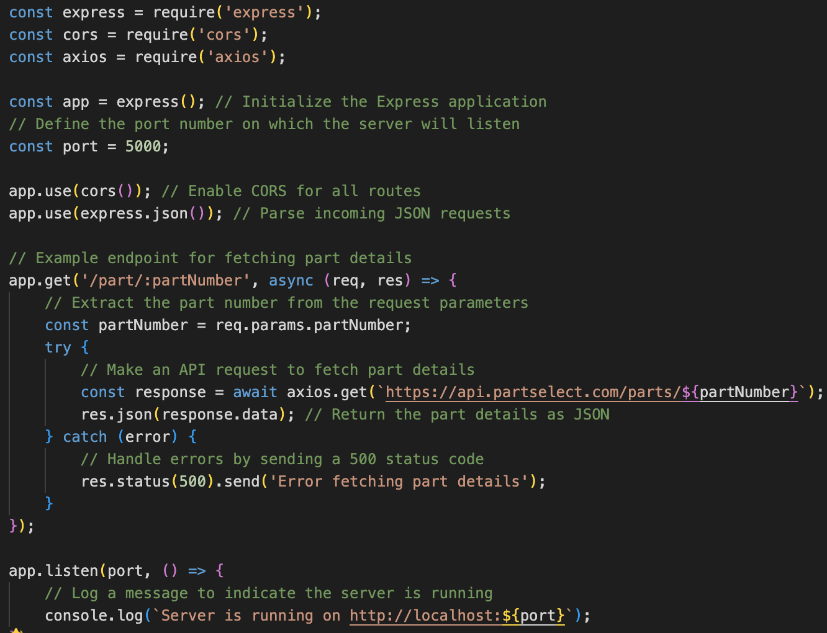
Implementing Backend Functionality.
1. Defining endpoints: We define an endpoint to fetch part details based on the part number provided in the request. This endpoint makes an API call to fetch data and then returns that data to the client.
}
..
Notes:
In this step, we will implement the core functionality of our backend. This involves defining endpoints to handle user queries, processing those queries, and returning appropriate responses. Let's go through the details.
We start by defining endpoints in our server.js file. Endpoints are the routes that handle different types of requests sent to our server. For our chat application, we need endpoints to fetch part details, check compatibility, and provide troubleshooting information.
We define an endpoint to fetch part details based on the part number provided in the request. This endpoint makes an API call to fetch data and then returns that data to the client.

Slide 8
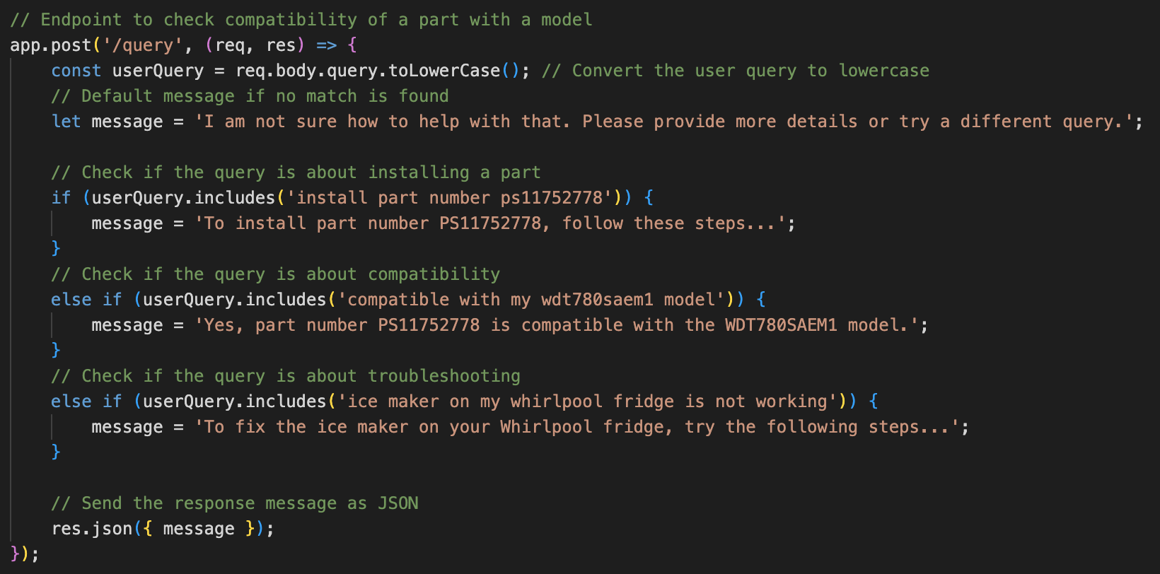
Implementing Backend Functionality.
2. In addition to fetching part details, we can define other endpoints to handle different types of queries. For example, checking compatibility and providing troubleshooting information.
}
..
Notes:
In addition to fetching part details, we can define other endpoints to handle different types of queries. For example, checking compatibility and providing troubleshooting information.
Handling User Queries:
"The backend processes user queries by checking if the query contains specific keywords or phrases. Based on the query, it determines the appropriate response and returns it to the client."
Detailed Steps:
Extract the User Query: Extract the user query from the request body.
Process the Query: Check if the query contains specific keywords or phrases related to part installation, compatibility, or troubleshooting.
Determine the Response: Set the response message based on the query type.
Send the Response: Return the response message as a JSON object.
Conclusion:
"By implementing these endpoints, we have equipped our backend with the functionality to handle various types of user queries. This forms the core of our chat application's ability to provide useful information to users based on their queries."
Summary:
"In summary, implementing backend functionality involved defining endpoints to handle different types of queries, processing those queries, and returning appropriate responses. This step ensures that our chat application can interact with users effectively and provide relevant information based on their inputs."

Slide 9
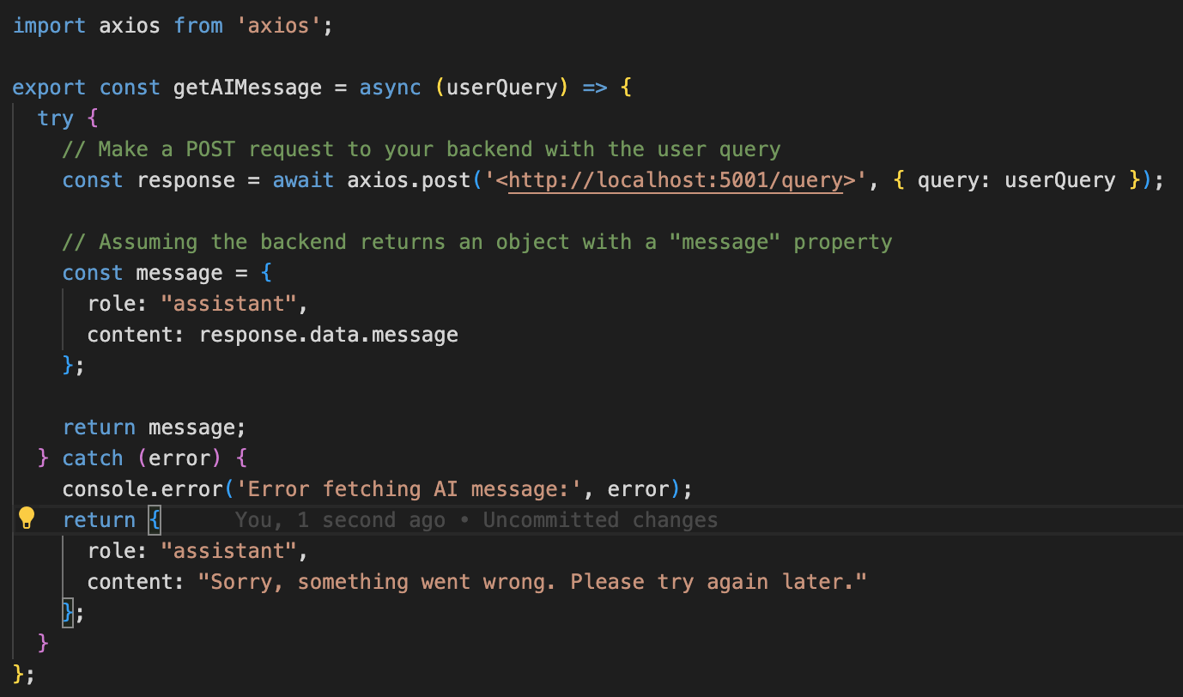
Integrating Frontend and Backend.
Step 1: Modify api.js to make API calls: Update the getAIMessage function to send user queries to the backend.
}
..
Notes:
Introduction:
"In this step, we focus on integrating our frontend with the backend to create a seamless user experience. The goal is to enable the frontend to send user queries to the backend and display the responses. We'll achieve this by modifying the api.js file and ensuring the backend can process these queries correctly.”
Step 1: Modify api.js to Make API Calls:
"We start by updating the getAIMessage function in api.js to send a POST request to the backend with the user query. This function will handle the API call and return the response from the backend."
Explanation:
axios.post('http://localhost:5001/query', { query: userQuery }): Sends a POST request to the backend with the user query.
response.data.message: Assumes the backend response contains a message property with the response text.
Return message: Constructs a message object to be returned to the frontend.

Slide 10
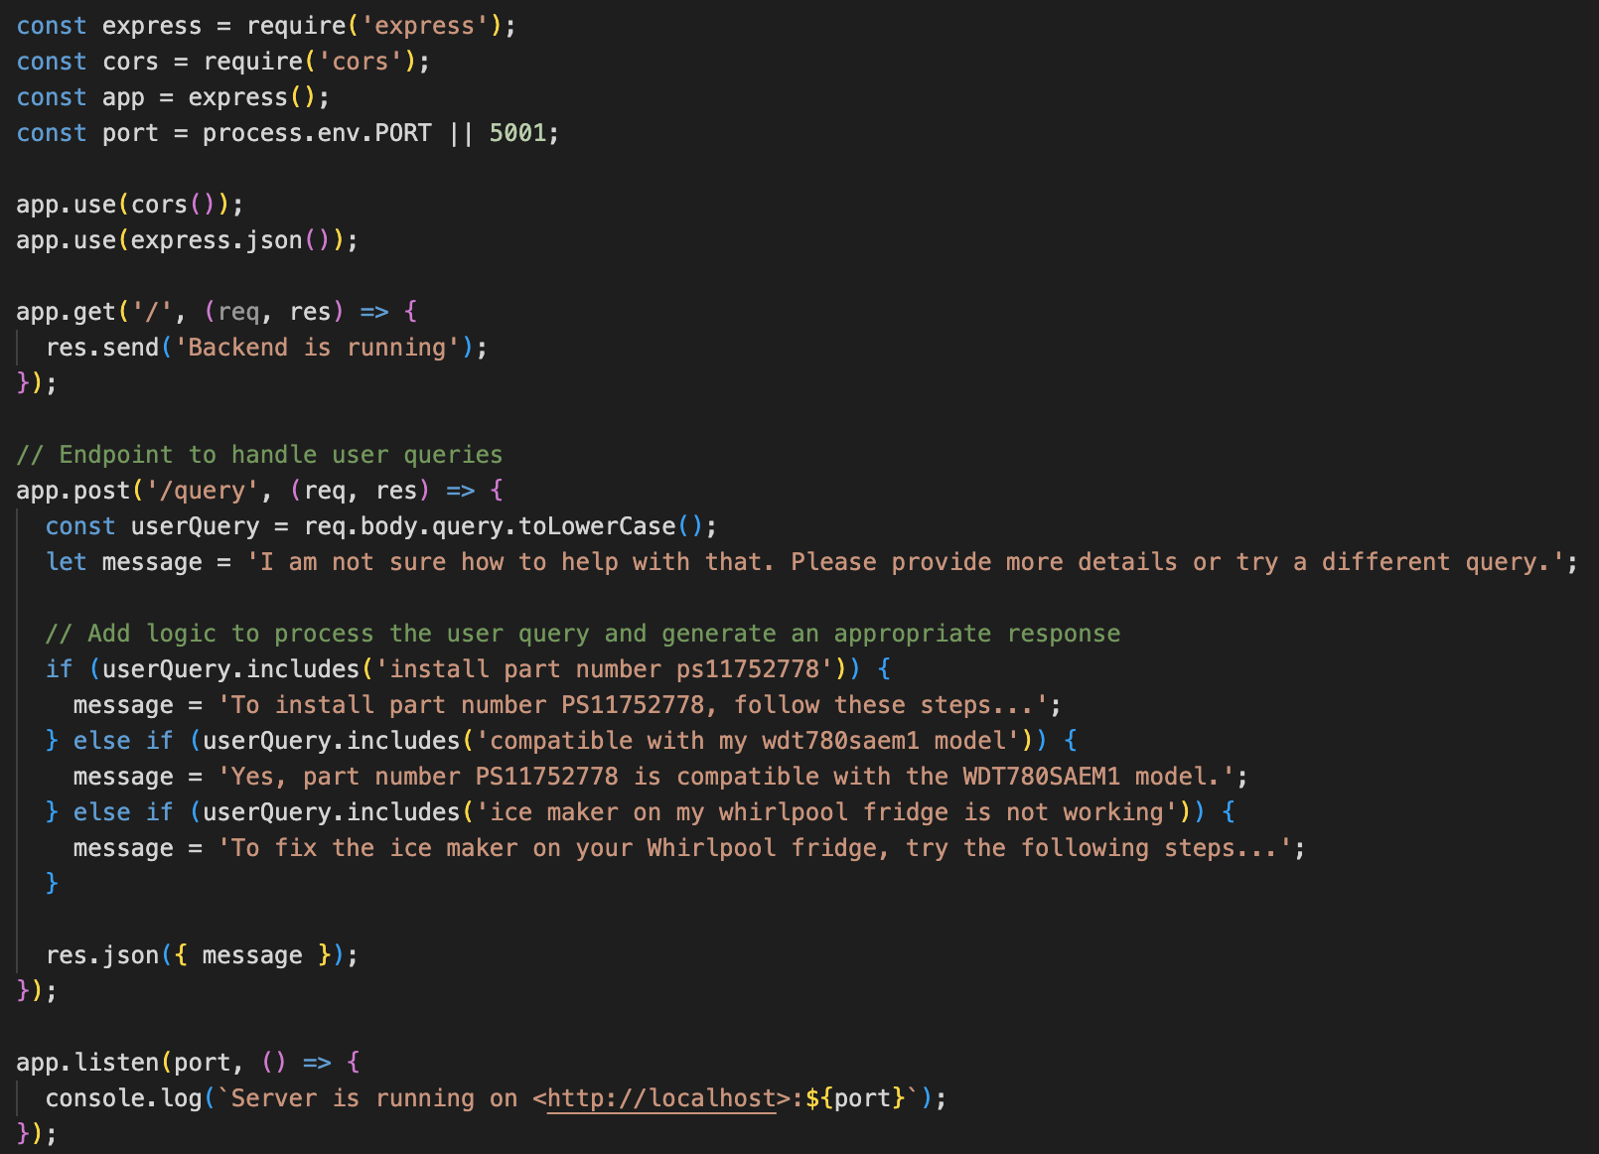
Integrating Frontend and Backend.
Step 2: Ensure the backend processes the queries: We achieve this by defining a POST endpoint in server.js to handle the queries.
}
..
Notes:
Step 2: Ensure Backend Processes the Queries:
"Next, we ensure that our backend can process the user queries and return appropriate responses. We achieve this by defining a POST endpoint in server.js to handle the queries.”
Explanation:
app.post('/query', (req, res) => { ... }): Defines a POST endpoint to handle user queries.
req.body.query.toLowerCase(): Extracts and converts the user query to lowercase for processing.
message: Sets the response message based on the query type.
res.json({ message }): Sends the response message as a JSON object.

Slide 11
Integrating Frontend and Backend.
Step 3: Integrate and test.
Challenge faced: While this approach worked, it was not scalable. It was only capable of answering the example questions present in the case study instructions. Since I had no access to a web API for the Part Select website, I had to result to web scraping as an alternative (credit to Iris for hinting at this).
Start the backend server: run the backend server using the command, node server.js, and verify the server is running in the browser.
Start the frontend application: using the command, npm start.
Test user queries: enter queries into the chat interface and verify that the responses from the backend are displayed correctly in the chat interface.
}
..
Notes:
Step 3: Integrate and Test:
"With the frontend and backend set up, the next step is to integrate and test the entire system. This involves running both the frontend and backend servers, sending queries through the frontend, and verifying that the responses are displayed correctly."
Conclusion:
"By following these steps, we have successfully integrated the frontend and backend. The frontend can now send user queries to the backend, which processes these queries and returns appropriate responses. This integration ensures a seamless and interactive user experience."
Summary:
"In summary, integrating the frontend and backend involved updating the api.js file to make API calls, ensuring the backend processes the queries correctly, and testing the integration. This step is crucial for enabling the chat application to interact with users and provide relevant information."

Slide 12
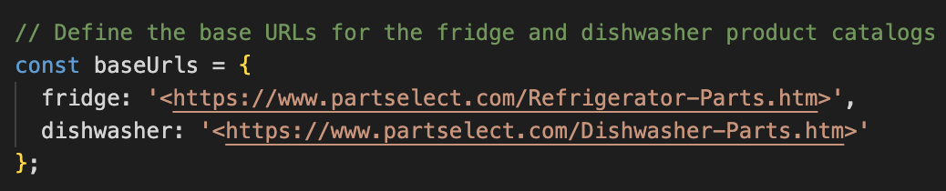
Web Scraping for more data.
Importance of web scraping:
Expand data coverage: Automatically collect data on many parts, ensuring our chat application can answer more queries.
Update data regularly: Keep out database (read JSON) up-to-date by periodically scraping the latest information.
}
..
URLS for the fridge and dishwasher product catalogs are defined.
Notes:
Introduction:
"In this step, we focus on web scraping to obtain more data for our chat application. The goal is to make our backend more scalable and capable of handling a wide range of queries related to refrigerator and dishwasher parts. We'll use web scraping techniques to gather detailed information from the PartSelect website."
Tools Used for Web Scraping:
"We used the following tools for web scraping:
Axios: A promise-based HTTP client for making requests to web pages.
Cheerio: A fast, flexible, and lean implementation of jQuery designed for server-side HTML manipulation and parsing.
Node.js File System (fs) Module: For reading and writing data to files."

Slide 13
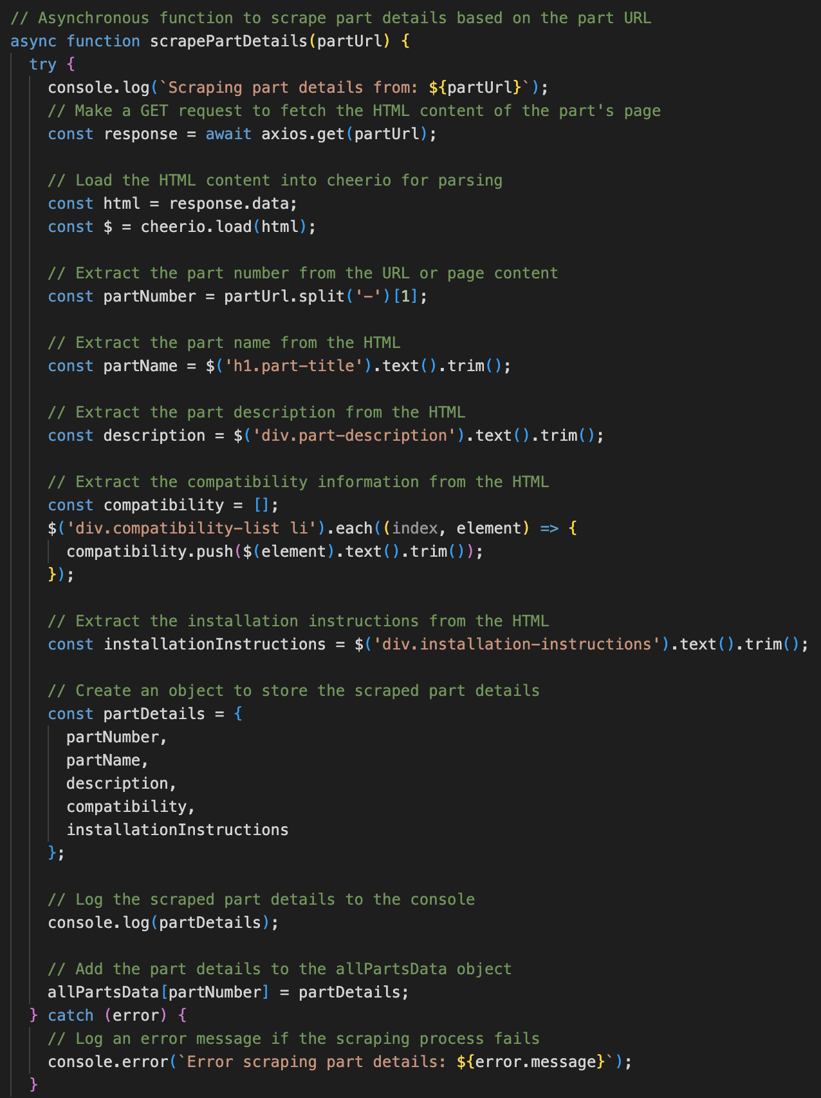
Web Scraping for more data.
scrapePartDetails function scrapes details from individual part pages.
}
..

Slide 14
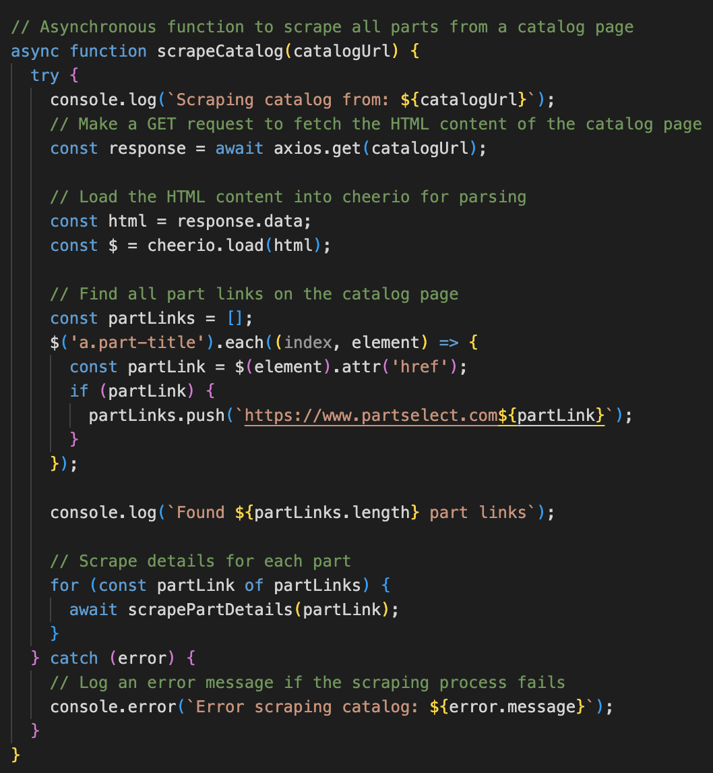
Web Scraping for more data.
scrapeCatalog function scrapes all part links from the catalog page and collects details using scrapePartDetails.
}
..

Slide 15
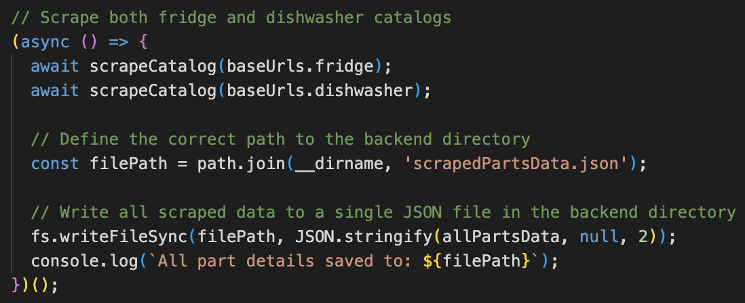
Web Scraping for more data.
}
Scraped data is saved to scrapedPartsData.json in the backend directory.
..
Notes:
"In summary, we used web scraping to gather detailed information on refrigerator and dishwasher parts from the PartSelect website. This data enhances our backend's ability to respond to user queries effectively, ensuring a better user experience."

Slide 16
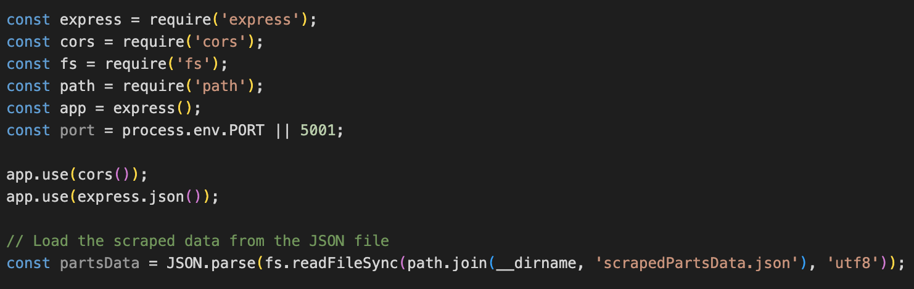
Integration of scraped data.
Load the scraped data into our backend server. This data is stored in a JSON file and contains detailed information about various parts. We’ll read this file when the server starts and use its contents to respond to user queries.
}
..
Notes:
Introduction:
"In this step, we focus on integrating the scraped data into our chat agent. The goal is to enhance the backend's ability to respond accurately to a wide range of user queries by leveraging the detailed information we have collected through web scraping.”
Explanation:
fs.readFileSync: Reads the contents of the scrapedPartsData.json file synchronously.
JSON.parse: Parses the JSON file content into a JavaScript object.
path.join(__dirname, 'scrapedPartsData.json'): Constructs the file path to the JSON file.

Slide 17
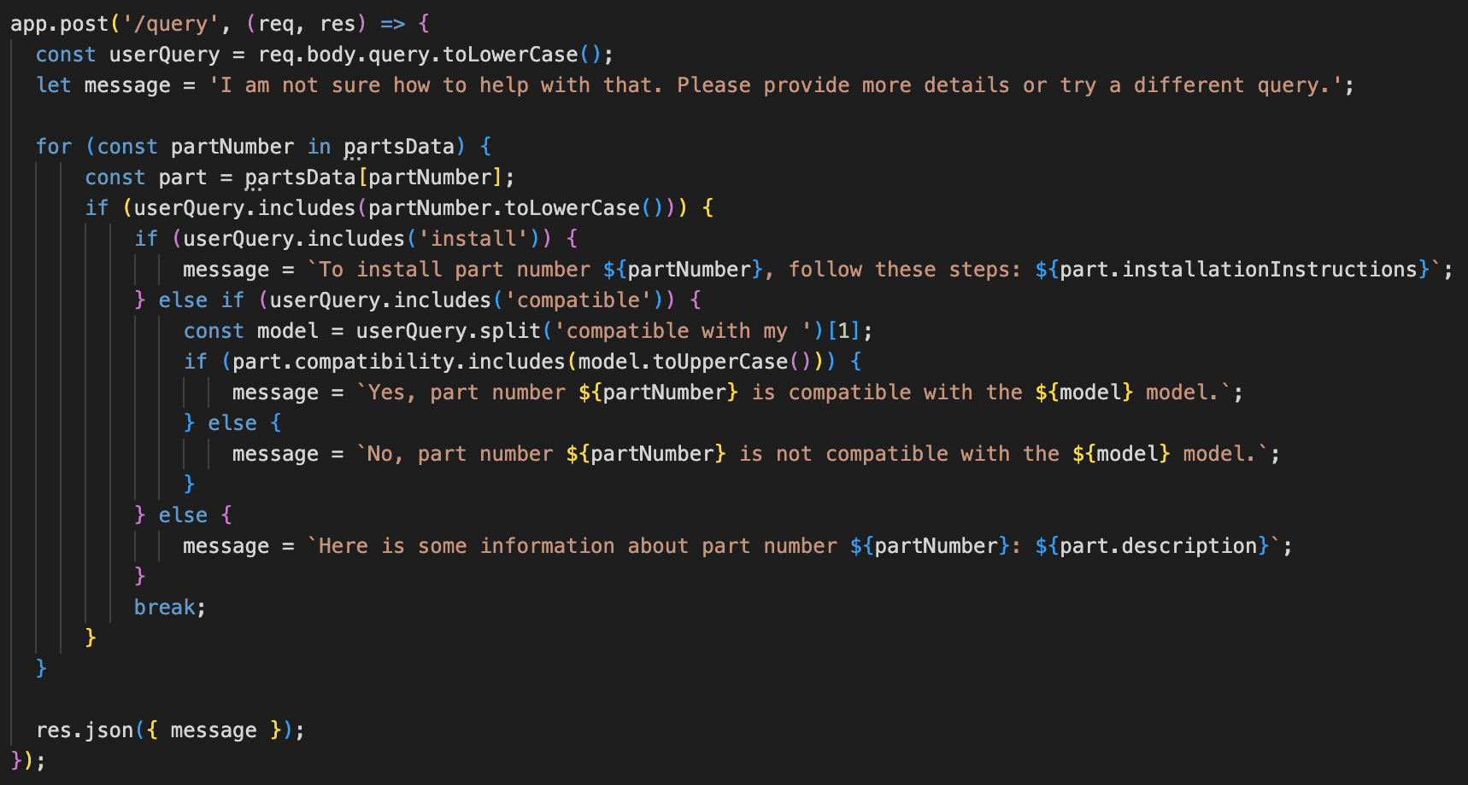
Integration of scraped data.
}
We update the endpoint that handles user queries. The endpoint will now use the scraped data to provide more detailed and accurate responses.
..

Slide 18
Integration of scraped data.
We can ensure the integration is successful by testing the chat agent with queries even beyond the examples in the case study instructions.
Challenge Faced:
While the frontend and backend were successfully running and the JSON file was being generated, the file unfortunately contained no part details.
It became evident that the web scraper was not functioning as intended, as it failed to scrape any part details, leaving the JSON file empty.
Despite dedicating many hours to debugging this issue, I was unable to resolve it before the deadline.
}
..
Notes:
Conclusion:
"By integrating the scraped data into our backend, we have significantly enhanced the chat agent's ability to provide accurate and detailed responses. This integration ensures that our chat application can handle a wide range of queries, making it more useful and reliable for users."
Summary:
"In summary, we loaded the scraped data into our backend, updated the query handling logic to use this data, and tested the integration to ensure accuracy and detail in responses. This step is crucial for making our chat application scalable and capable of handling diverse queries."

Slide 19
Conclusion and Next Steps.
Summary of Achievements:
Technology Stack Selection: We carefully chose Node.js with Express, Axios, and CORS to build a robust and scalable backend.
Backend Setup: We successfully set up the backend server, configured middleware, and created endpoints to handle various user queries.
Integration with Frontend: We integrated the frontend with the backend, ensuring seamless communication and data exchange.
Error Handling: We implemented comprehensive error handling mechanisms to ensure a smooth user experience.
Web Scraping: We developed a web scraping script to collect detailed part information from the PartSelect website, enhancing our backend's data repository.
Data Integration
}
..

Slide 20
Conclusion and Next Steps.
Next Steps:
Fix the Scraper: Investigate and resolve the issues with the web scraper to ensure it collects the necessary part details.
Automate Data Updates: Implement a schedule to run the scraper periodically, ensuring the data remains up-to-date.
Expand Functionality: Add more endpoints and capabilities to the backend to handle a wider range of queries and improve user experience.
}
..
Notes:
In conclusion, this project has laid a solid foundation for a scalable and extensible backend system. While there are challenges to address, the progress made so far demonstrates the potential for building a powerful and reliable chat application. By continuing to refine and enhance the system, we can ensure it meets the needs of users and delivers a high-quality experience.

